Slide 1
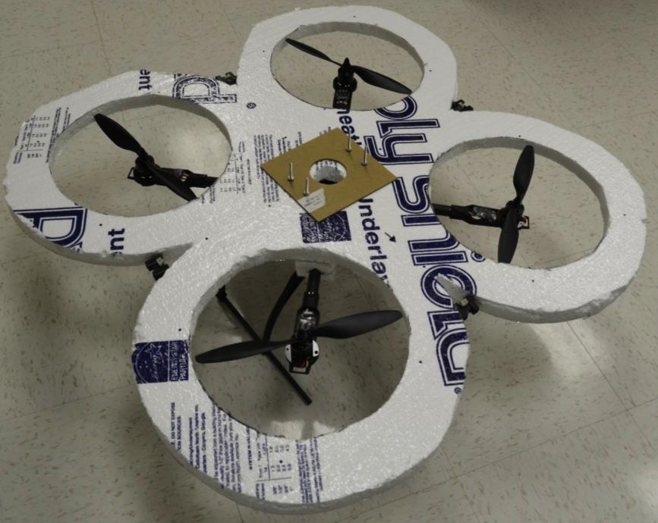
Aerial Collision Avoidance System
Brad Bergerhouse, Nelson Gaske, Austin Wenzel
Dr. Malinowski
Notes:
A

Slide 2
Outline
Description
Rationale
Goals
Hardware Subsystems
Software Subsystems
Results
Notes:
B

Slide 3
Description
Implement collision avoidance system on a quadcopter platform
Use minimal sensor input to accomplish avoidance
IR rangefinders and Camera input used for obstacle detection
Notes:
N

Slide 4
Rationale
Aerial Project
New project for department
Push our Linux knowledge
Complex System
Notes:
B

Slide 5
Goals
Use various sensors to detect obstacles
Autonomously avoid obstacles in the path
Eliminate collisions due to human error
Notes:
A

Slide 6
Hardware Systems
Xaircraft X650 Platform
BeagleBoard-xM
IR range finders
Battery and power system
Camera for Image Processing
Notes:
A

Slide 7
Block Diagram
Notes:
B

Slide 8
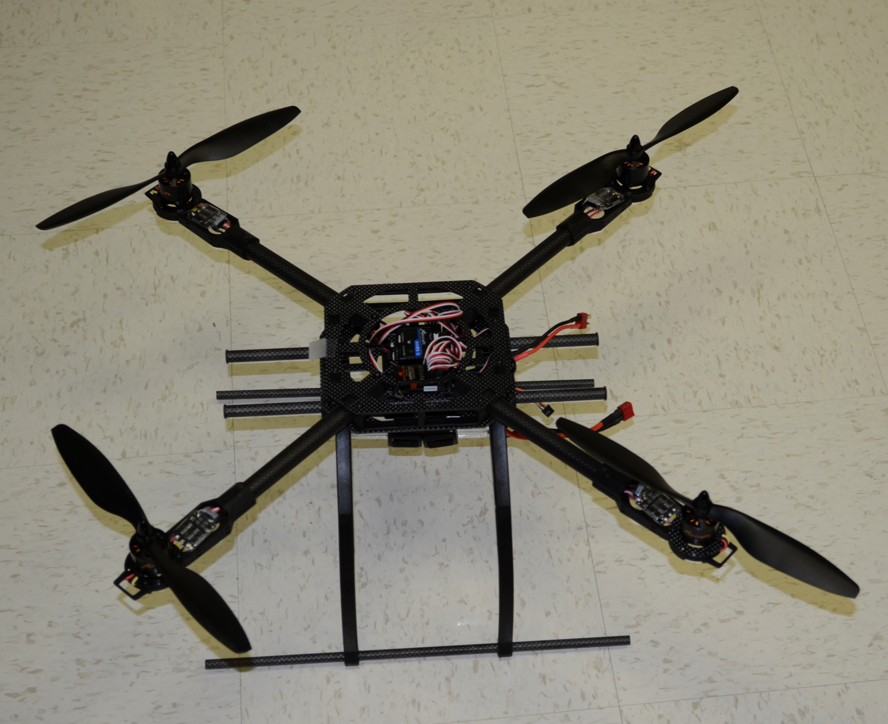
XAircraft X650 Quadcopter Platform
Notes:
N

Slide 9
Notes:
N

Slide 10
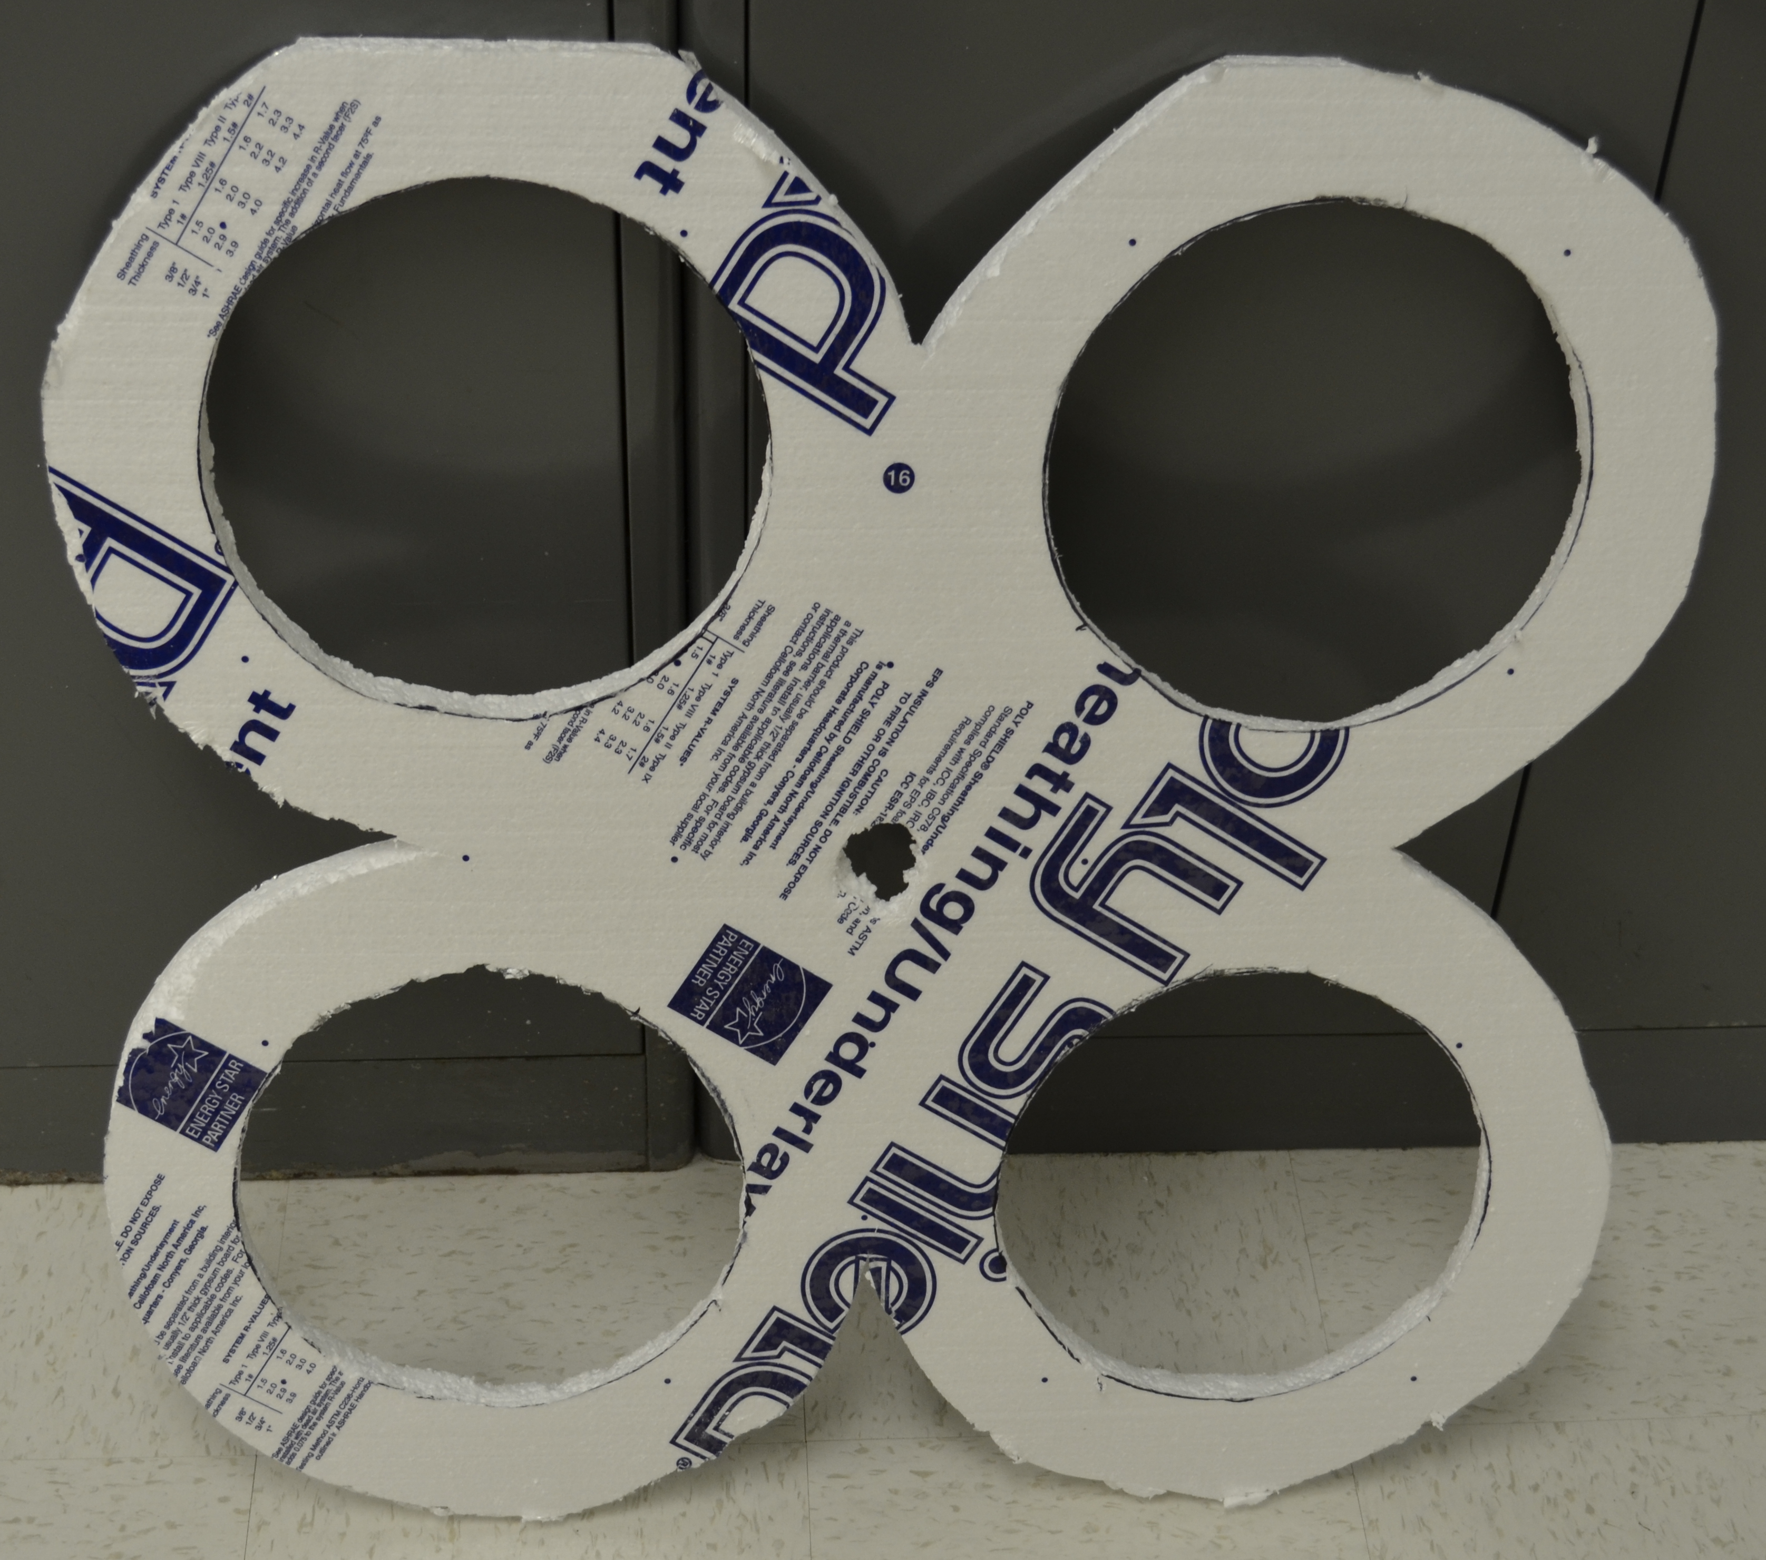
Rotor Guards
Notes:
N

Slide 11
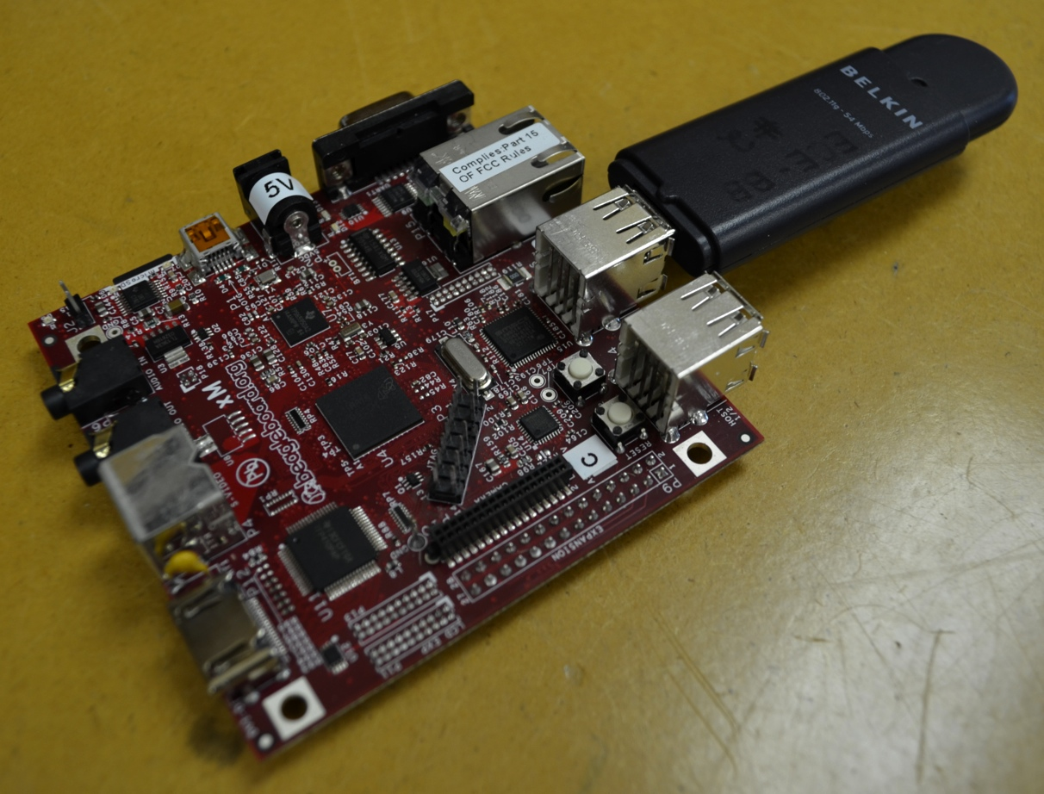
BeagleBoard-xM
Includes TI OMAP DM3730 Processor
USB, I2C and serial communication interfaces
SD Card storage
Notes:
A

Slide 12
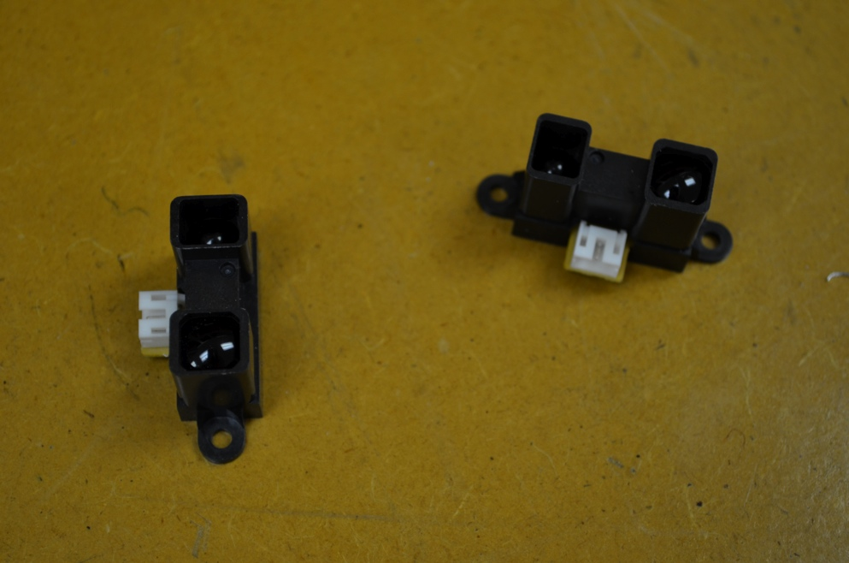
IR Range Finders
Sharp GP2Y0A02YK0F Sensors
Effective Range 15-150cm
Supply Voltage: 5V
Output Voltage: 0-3V
Notes:
N

Slide 13
IR Range sensor interpolation
Notes:
B

Slide 14
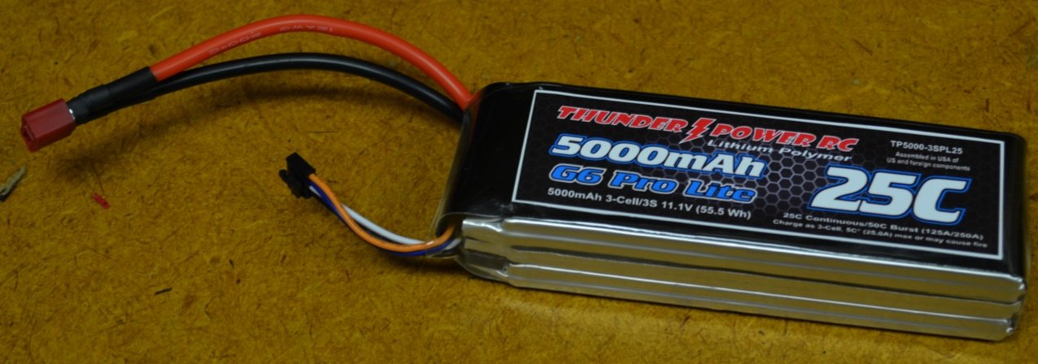
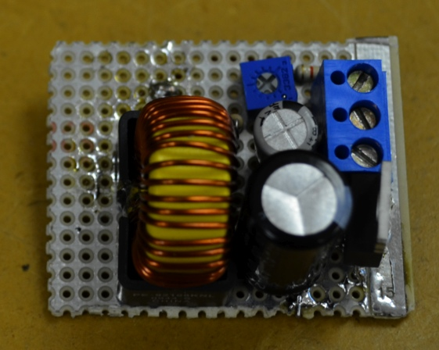
Battery and Power System
Thunder Power 11.1V 3S 5000mAh LiPo
5V switching regulator
Notes:
N

Slide 15
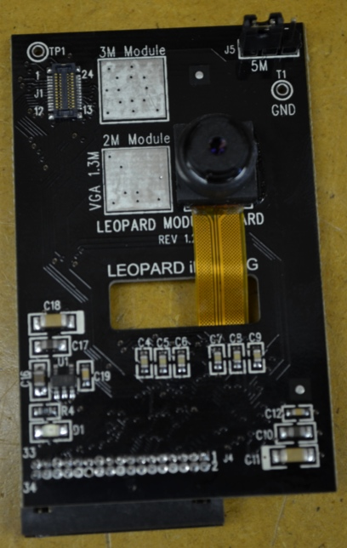
Camera for Image Processing
Leopard imaging LI-LBCM5M1
5 Megapixel
Parallel input
Notes:
A

Slide 16
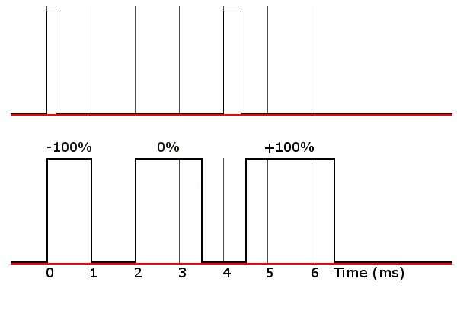
RC PWM
Pulses at 50Hz
High time 1ms to 2ms
Remaining cycle low voltage
Requires high precision and low jitter
Notes:
B

Slide 17
Software Systems
Angstrom Linux on the BeagleBoard
Real-time Xenomai subsystem
I²C sensor interface
Image Processing
Notes:
B

Slide 18
Angstrom Linux
Lightweight Linux distribution
Designed for embedded systems
Prebuilt and configured image
Compatible with Beagleboard-xM hardware
Notes:
B

Slide 19
Real-time Xenomai Framework
Set of patches for Linux kernel
Enables real-time kernel features
Provides framework for accurate timing
Necessary for precise timing in PWM generation
Notes:
B

Slide 20
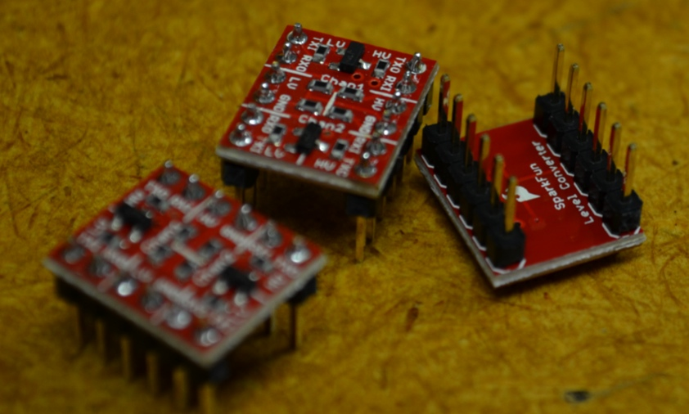
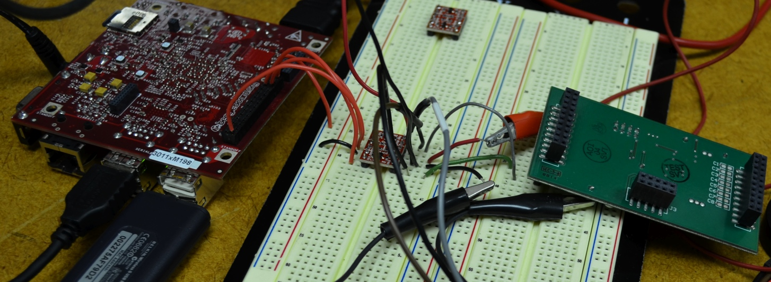
I²C interface
1.8V logic on BeagleBoard
5V logic on ADC Board
Level converter used to interface
Notes:
N

Slide 21
Image Processing
Images captured via camera
Pixel information is transferred in parallel
DSP core processes pixel information
Processed pixels are sent to ARM core
Notes:
A

Slide 22
Color Distance
Calculate a pixel’s distance from a given color
$D=\sqrt{dR^{2}+dG^{2}+db^{2}}$
Pixel color is updated in relation to distance
Brighter pixels are closer and darker pixels are farther away
Notes:
A

Slide 23
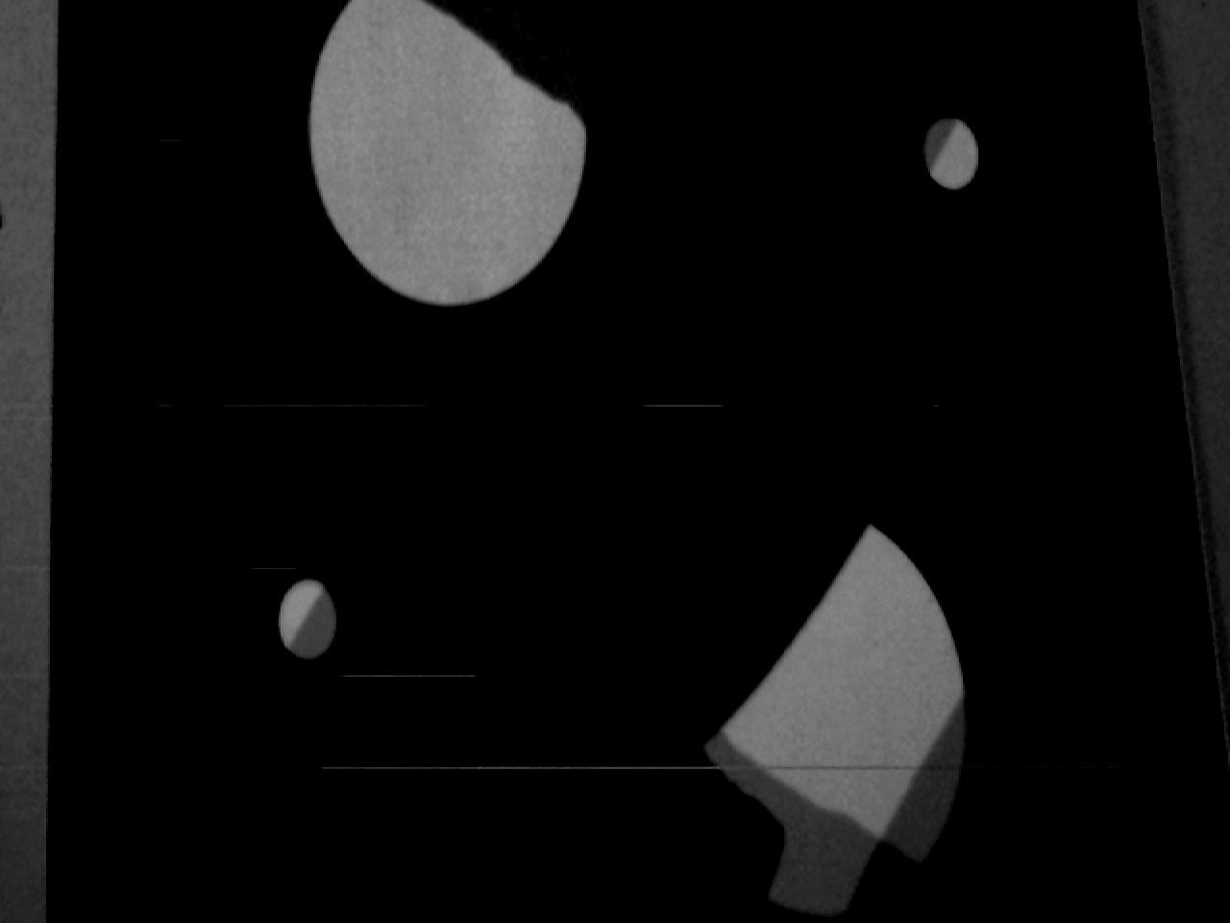
Color Distance
Notes:
A

Slide 24
Results
Platform Design and Assembly
Sensor Interfacing
RC PWM
Image Processing
Power Distribution
Notes:
N

